Slide 1

Database Management Systems
Shamim Ahmad

Slide 2
Why Database Design is Important
Defines the database’s expected use
Different approach needed for different types of databases
Avoid redundant data
Poorly designed database generates errors → leads to bad decisions → can lead to failure of organization

Slide 3
Purpose of Database System
In the early days, database applications were built on top of file systems

Slide 4
Purpose of Database System
Drawbacks of using file systems to store data:
Data redundancy and inconsistency
Multiple file formats, duplication of information in different files
Difficulty in accessing data
Need to write a new program to carry out each new task
Data multiple files and formats
Integrity problems
Integrity constraints (e.g. account balance > 0) become part of program code
Hard to add new constraints or change existing ones

Slide 5
Older Database Management System

Slide 6
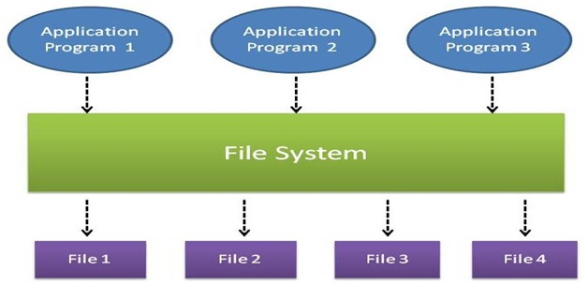
Historical Roots: Files and File Systems (continued)

Slide 7
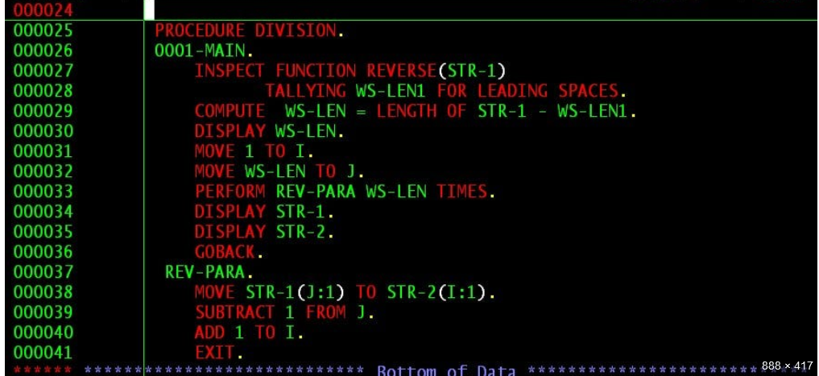
COBOL Example

Slide 8
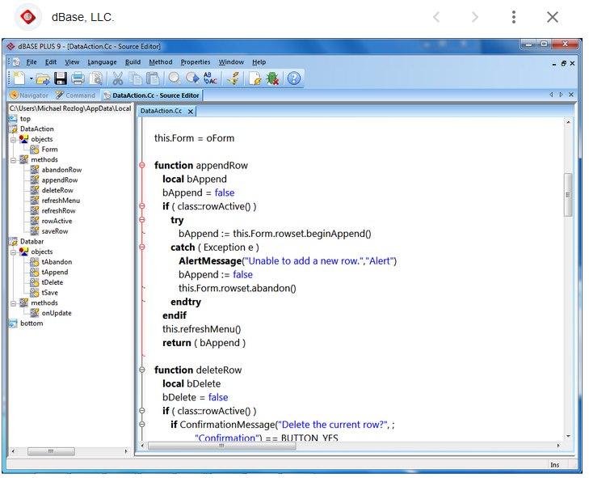


Slide 9
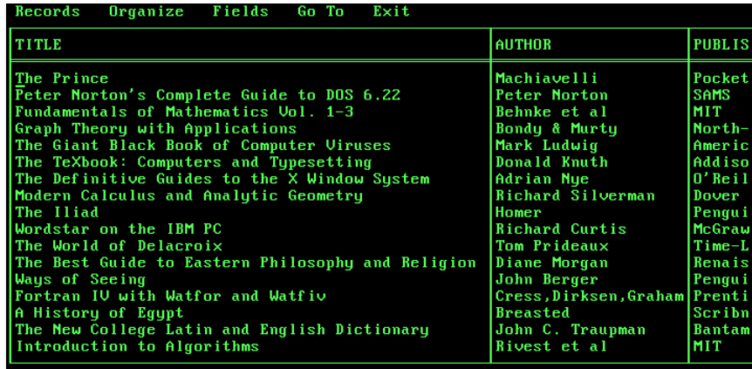

Slide 10
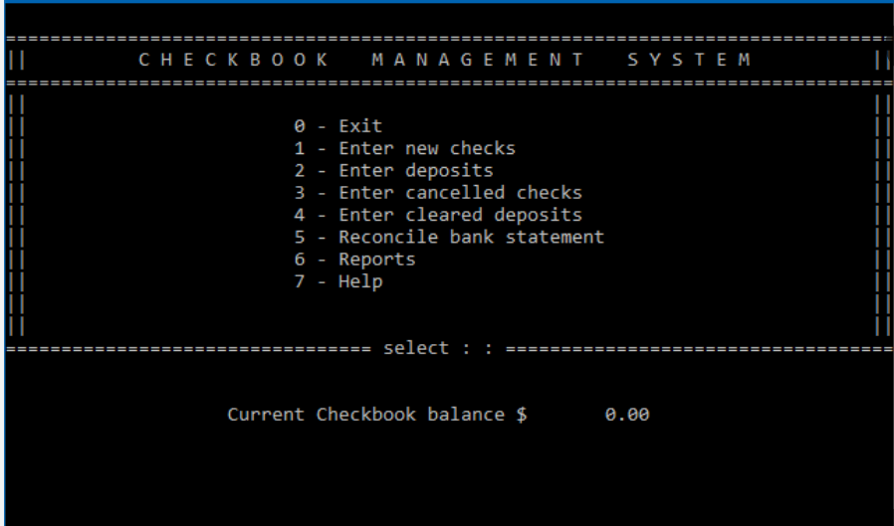

Slide 11
Purpose of Database Systems (Cont.)
Drawbacks of using file systems (cont.)
Atomicity of updates
Failures may leave database in an inconsistent state with partial updates carried out
E.g. transfer of funds from one account to another should either complete or not happen at all
Concurrent access by multiple users
Concurrent accessed needed for performance
Uncontrolled concurrent accesses can lead to inconsistencies
E.g. two people reading a balance and updating it at the same time
Security problems
Database systems offer solutions to all the above problems

Slide 12
Historical Roots: Files and File Systems
Managing data with file systems is obsolete
Understanding file system characteristics makes database design easier to understand
Awareness of problems with file systems helps prevent similar problems in DBMS
Knowledge of file systems is helpful if you plan to convert an obsolete file system to a DBMS

Slide 13
Historical Roots: Files and File Systems (continued)
Manual File systems:
Collection of file folders kept in file cabinet
Organization within folders based on data’s expected use (ideally logically related)
System adequate for small amounts of data with few reporting requirements
Finding and using data in growing collections of file folders became time-consuming and cumbersome

Slide 14

Purpose of Database System

Slide 15
Historical Roots: Files and File Systems (continued)
Conversion from manual to computer system:
Could be technically complex, requiring hiring of data processing (DP) specialists
Initially, computer files were similar in design to manual files

Slide 16
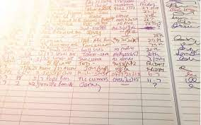
Historical Roots: Files and File Systems (continued)

Slide 17
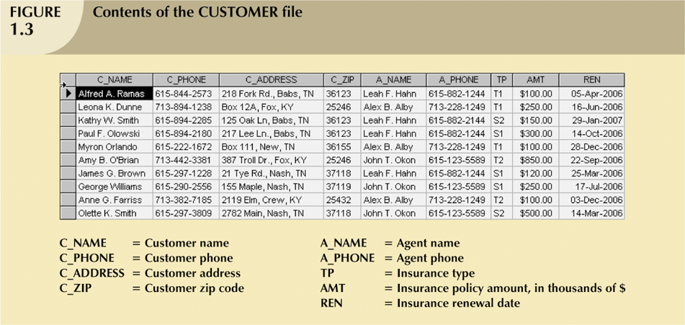
Historical Roots: Files and File Systems (continued)

Slide 18
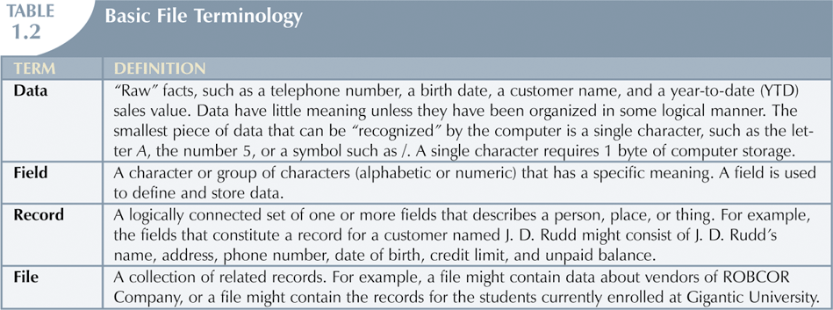
Historical Roots: Files and File Systems (continued)

Slide 19
Historical Roots: Files and File Systems (continued)
DP specialist wrote programs for reports:
Monthly summaries of types and amounts of insurance sold by agents
Monthly reports about which customers should be contacted for renewal
Reports that analyzed ratios of insurance types sold by agent
Customer contact letters summarizing coverage

Slide 20
Historical Roots: Files and File Systems (continued)
Other departments requested databases be written for them
SALES database created for sales department
AGENT database created for personnel department

Slide 21
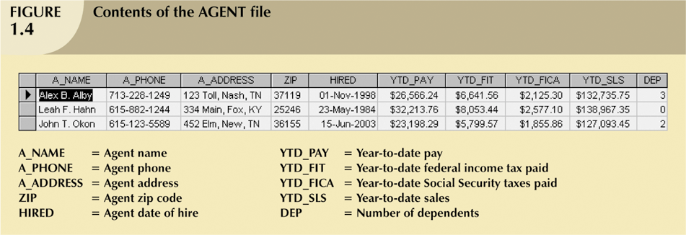
Historical Roots: Files and File Systems (continued)

Slide 22
Historical Roots: Files and File Systems (continued)
As number of databases increased, small file system evolved
Each file used its own application programs
Each file was owned by individual or department who commissioned its creation

